Slide 1
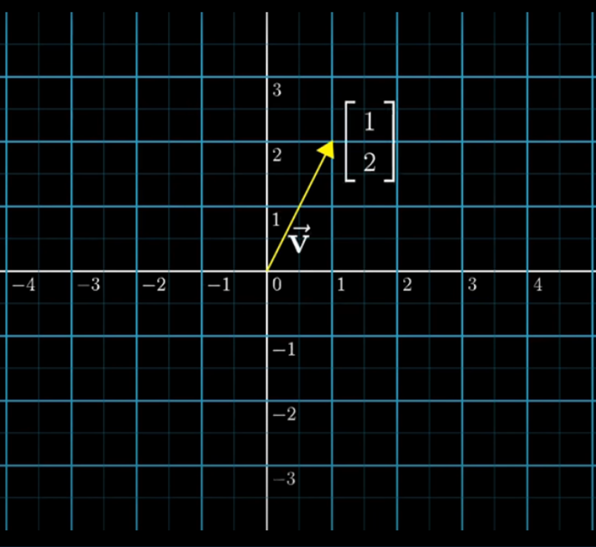
LAST LECTURE
In the last lecture we have studied
Introduction To Linear Algebra
Vectors And Independence Of Vectors
Matrix And Its Types
Echelon And Reduced Row Echelon
Form

Slide 2
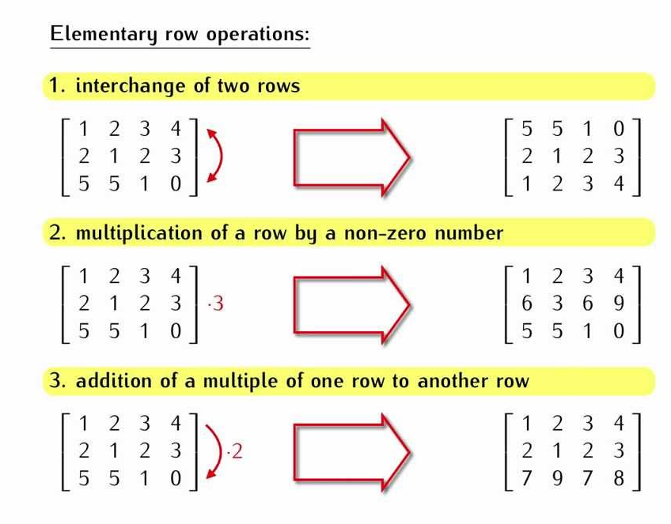
USING REDUCED ROW ECHELON FORM
To convert a given system of linear
equation into reduced row echelon
form we have to use elementary
row operations which are as follows
Interchange of any two rows
Multiplication of a row by a non
zero number. i.e. (1/C)R_{i} ,where C
is a constant
iii. Addition of a multiple of one row
to another i.e. R_{i} – DR_{j} , here D is a
constant

Slide 3
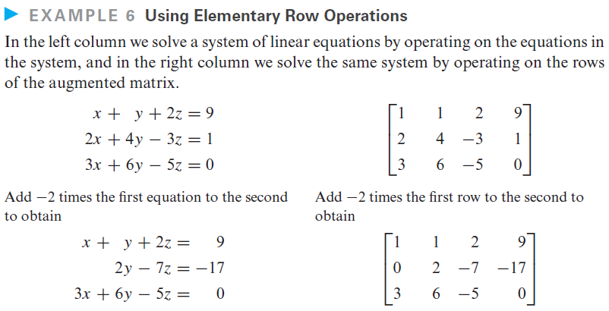

Slide 4
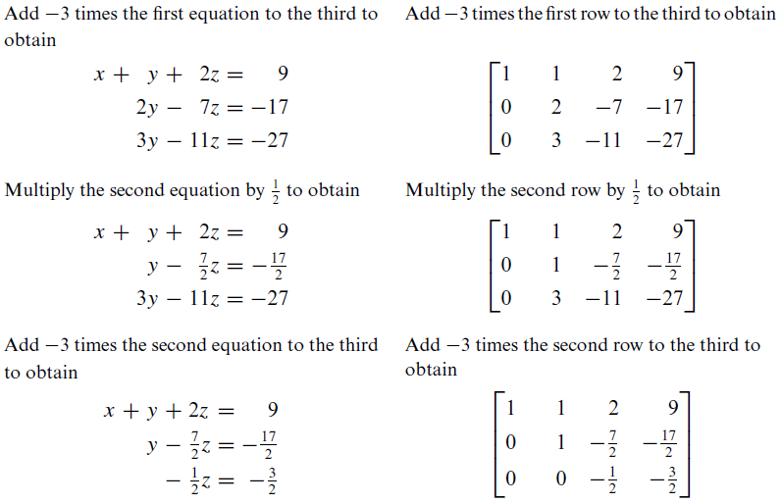

Slide 5
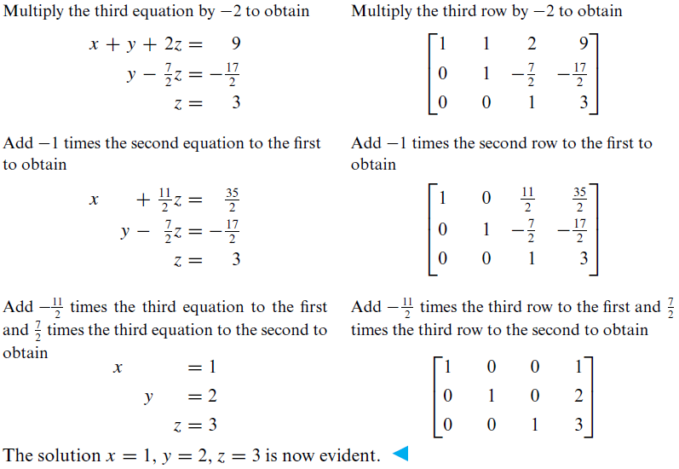

Slide 6
RANK OF A MATRIX
DEFINITION:
Rank of a matrix is the maximum no. of linearly independent row/column vectors.
Rank of a matrix can be calculated by two methods
By finding highest order non zero minor
By using reduced row echelon form

Slide 7
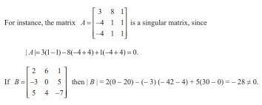
SINGULAR MATRIX
The singular matrix is a matrix whose determinant is 0.

Slide 8
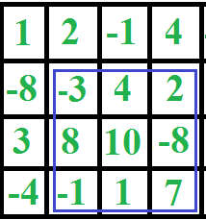
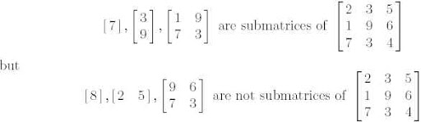

HIGHEST ORDER NON ZERO MINOR
The value of rank can be 3, 2, 1 or 0
Suppose we have a Matrix ‘A’
Rank(A) = 3 iff, A is a non singular matrix i.e. $\left|A\right|$ ≠ 0.
Rank(A) = 2 iff, A is a singular matrix i.e. $\left|A\right|$ = 0
and at least one of its sub matrix is non singular
i.e. $\left|\text{A}\text{1}\right|$ ≠ 0.

Slide 9

CONT.
Rank(A) = 1, iff A is a singular matrix i.e. $\left|A\right|$ = 0.
Rank(A) = 0 iff, A is a null matrix.

Slide 10

EXAMPLE: Finding rank by using ‘highest order non zero minor’
Suppose that we are given a matrix
A = $\left[\begin{aligned}−1 −2 −3 \\ 3 4 5 \\ 4 5 6\end{aligned}\right]$
$\left|A\right|$= $\left|\begin{aligned}−1 −2 −3 \\ 3 4 5 \\ 4 5 6\end{aligned}\right|$
$\left|A\right|$ = -1(24-25)-(-2)(18-20)-3(15-16)
$\left|A\right|$ = 0 singular matrix
As this is a singular matrix therefore we can say that it has rank = 1 0r 2

Slide 11


CONT.
A = $\left[\begin{aligned}−1 −2 −3 \\ 3 4 5 \\ 4 5 6\end{aligned}\right]$
$\left|\text{A}\text{1}\right|$ = $\left|\begin{aligned}−1 −2 \\ 3 4\end{aligned}\right|$
$\left|\text{A}\text{1}\right|$ = -4-(-6)
$\left|\text{A}\text{1}\right|$ = 2 non singular matrix
So,
Rank(A) = 2
Remember that
Rank(A) = 2 iff, A is a singular matrix i.e. $\left|A\right|$ = 0
and at least one of its sub matrix is non singular
i.e. $\left|\text{A}\text{1}\right|$ ≠ 0.

Slide 12


EXAMPLE 2
A = $\left[\begin{aligned}1 0 2 \\ 0 2 4 \\ 0 2 2\end{aligned}\right]$
$\left|A\right|$ = $\left|\begin{aligned}1 0 2 \\ 0 2 4 \\ 0 2 2\end{aligned}\right|$
$\left|A\right|$ = 1(4-8) – 0(0-0) + 2(0-0)
$\left|A\right|$ = -4
Here $\left|A\right|$ ≠ 0 so matrix A is non singular
So, Rank(A) = 3
Remember that
Rank(A) = 3 iff, A is a non singular matrix i.e. $\left|A\right|$ ≠ 0.

Slide 13
RANK OF A MATRIX BY USING REDUCED ROW ECHELON FORM
Rank of Matrix A = no. of non zero rows in reduced row echelon form.
We will count the no. of non zero rows in the final matrix that we will obtain after applying elementary row operations.

Slide 14
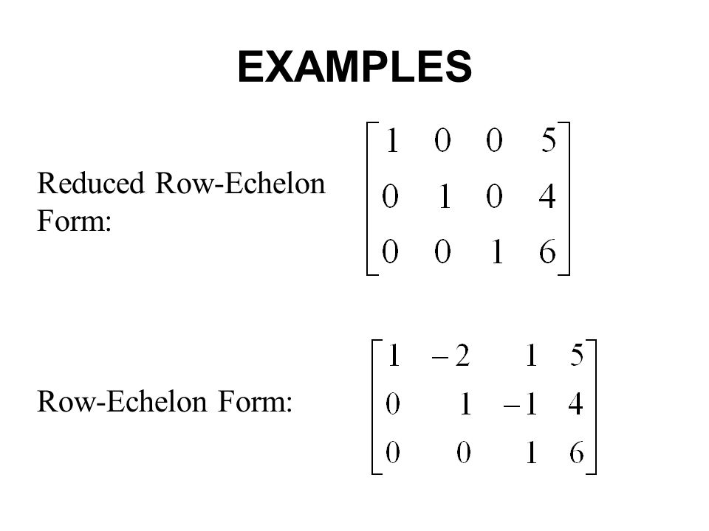
ECHELON AND REDUCED ROW ECHELON FORM

Slide 15
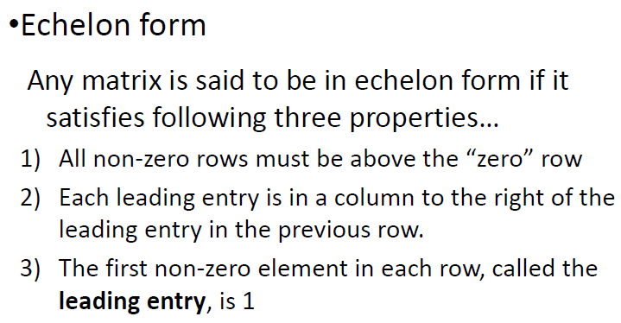

Slide 16
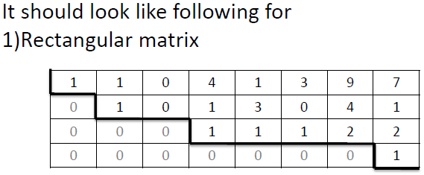

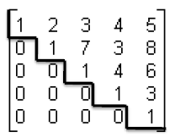

Slide 17
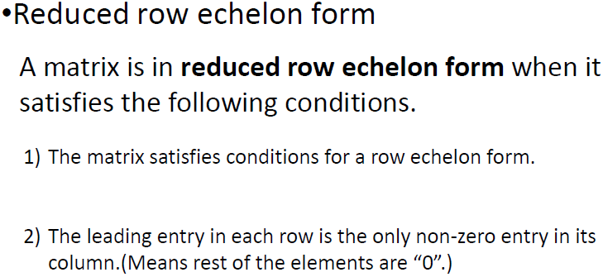

Slide 18
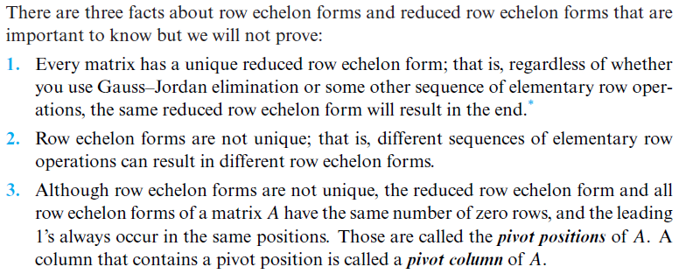

Slide 19
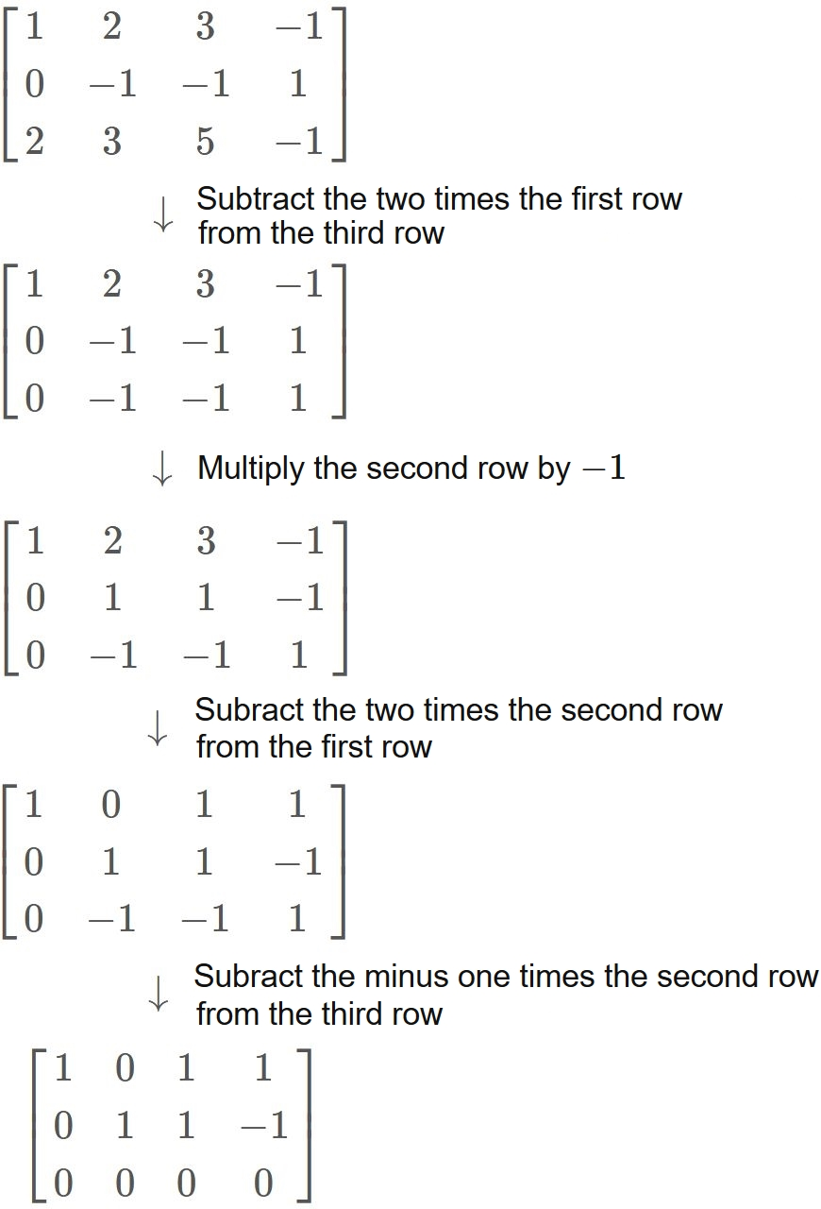
EXAMPLE
R₃ – 2R₁
Rank of a matrix by using
Reduced row echelon
Form
R_{i} +– DR_{j}
R_{i} =The row which we want to
change
R_{j} = The row, with which we want to
Solve (that contain diagonal
element)
-1R₂ OR R₂/-1
R₁ - 2R₂
R₃ + 1R₂

Slide 20
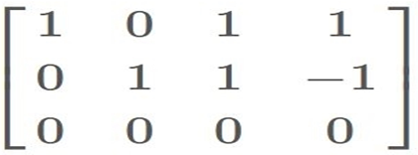
CONT.
Rank of Matrix = no. of non zero rows
So Here,
Rank = 2
Non zero rows
Zero row

Slide 21
PROPERTIES OF RANK
R(A) = R(A^{t})
Elementary transformations will not change rank of a matrix
Only null matrix has rank = 0, others atleast have rank = 1.

Slide 22
CONSISTENCY
DEFINITION:
In algebra a linear system of equation is
consistent if there is atleast one set of
values for the unknowns that satisfies
every equation in the system of equations.
CONSISTENT
Unique solution
Infinite Solution
INCONSISTENT
No solution

Slide 23
CONSISTENCY BY USING RANK
UNIQUE SOLUTION => R(A) = 3
INFINITE SOLUTION => R(A) < 3
NO SOLUTION => R(A) > 3

Slide 24
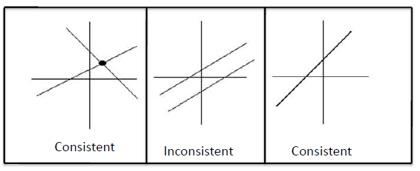
Consistent & Inconsistent system

Slide 25

EXAMPLE:
X + Y + Z = 9
2X + 5Y + 7Z = 52
2X + Y - Z = 0
So the augmented matrix is
$$\left[\begin{aligned}1 1 1 9 \\ 2 5 7 52 \\ 2 1 −1 0\end{aligned}\right]$$

Slide 26
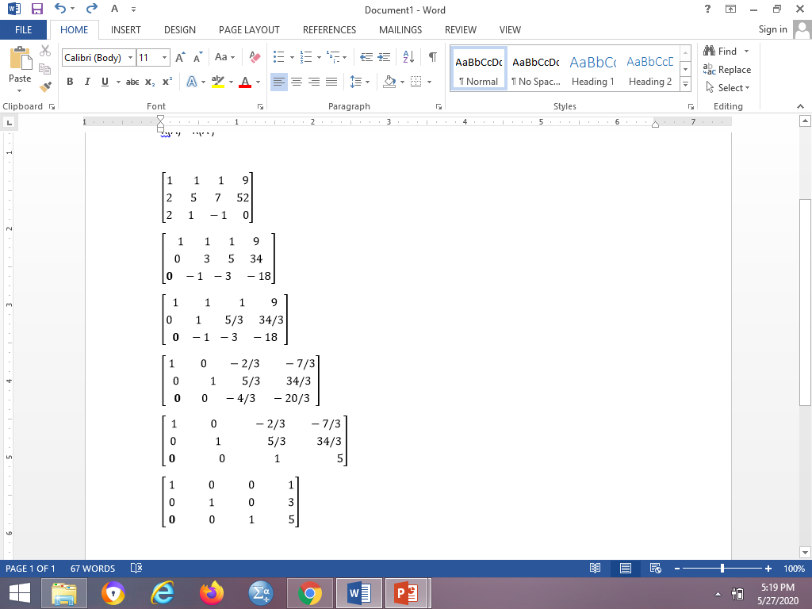
SOLUTION
R₃ – 2R₁
R₂ – 2R₁
R₂/3
so by considering the last
matrix we can say that this is a
Unique solution and for unique
Solution rank(A) = 3 and this
system of equation is consistent.
We can also see that there are
3 non zero rows in the last matrix
So, rank = 3.
R₃ + R₂
R₁ –R₂
(-3/4)R₃
R₁ + (2/3)R₃
R₂ – (5/3/)R₃

Slide 27
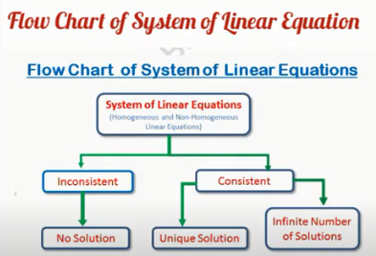

Slide 28
Consistency Criteria
Rank A = Rank A_{b} = number 0f unknowns → single solution
Rank A = Rank A_{b} < number 0f unknowns → infinite solutions
Rank A < Rank A_{b} → no solution
System is consistent for trivial and non-trivial solution
System is in consistent for no solution

Slide 29
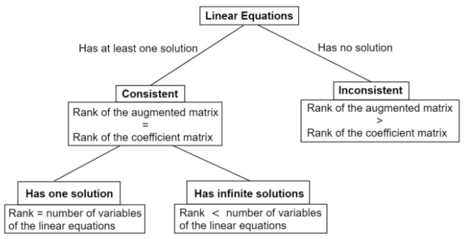

Slide 30
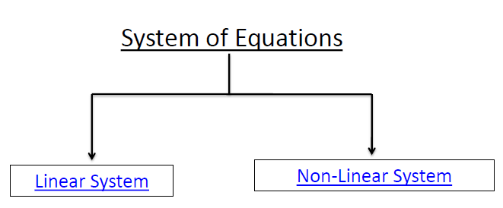

Slide 31
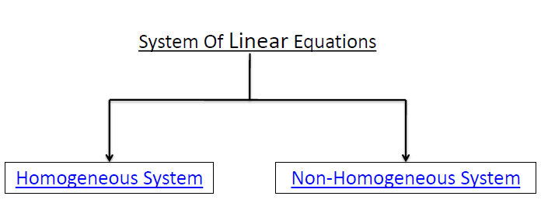

Slide 32
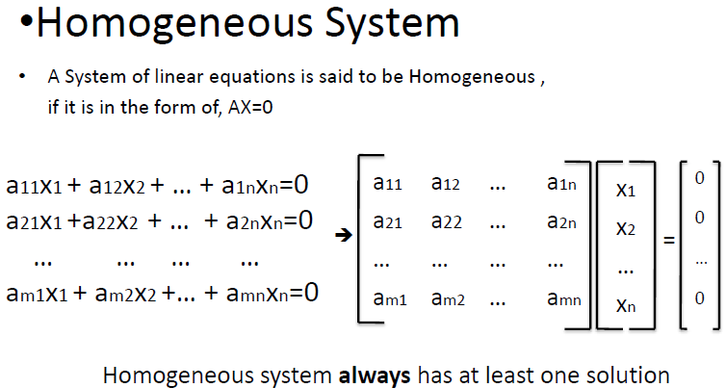

Slide 33
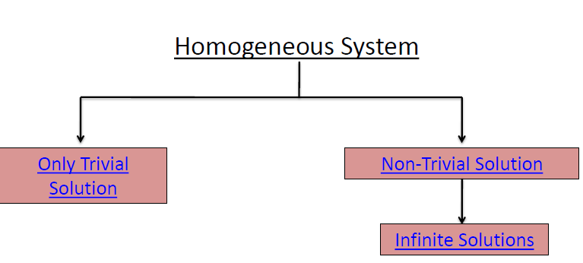

Slide 34
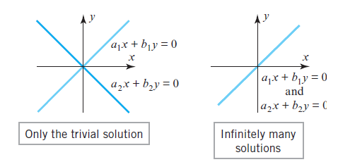

Slide 35
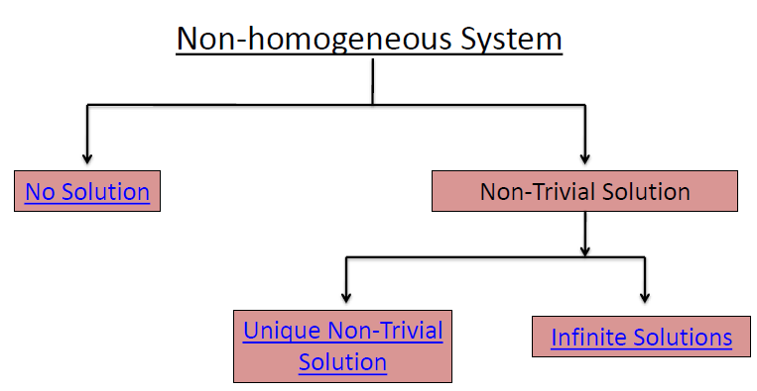

Slide 36
Trivial and non trivial solution
The system of equation in which the determinant of the coefficient matrix is zero is called non trivial solution.
The system of equation in which the determinant of the coefficient matrix is not zero but the solutions are x=y=z=0 is called trivial solution.
In fact the trivial solutions occur in homogeneous equations in which constant terms are equal to zero.

